Slide 1
Building an Interactive Dashboard with R Shiny in Data Science Experience
Greg Filla
IBM Data Science Experience Offering Manager
gfilla@us.ibm.com
1
Notes:
My name is Greg Filla and today I’ll be covering how to build an interactive dashboard using R Shiny. I work as a product manager for Data Science Experience, so today I encourage you to try out this dashboard in dsx. I’ll explain later a bit more about Data Science Experience, but first let’s look at what we’ll be building today.

Slide 2
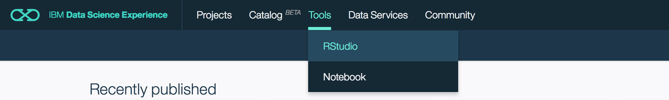
Before getting started:
Create account at datascience.ibm.com if you haven’t already
Go to Rstudio in Data Science Experience:
Start following steps at https://github.com/gfilla/BankLoanPrediction/ (takes ~5 minutes total for download/upload)

Slide 3
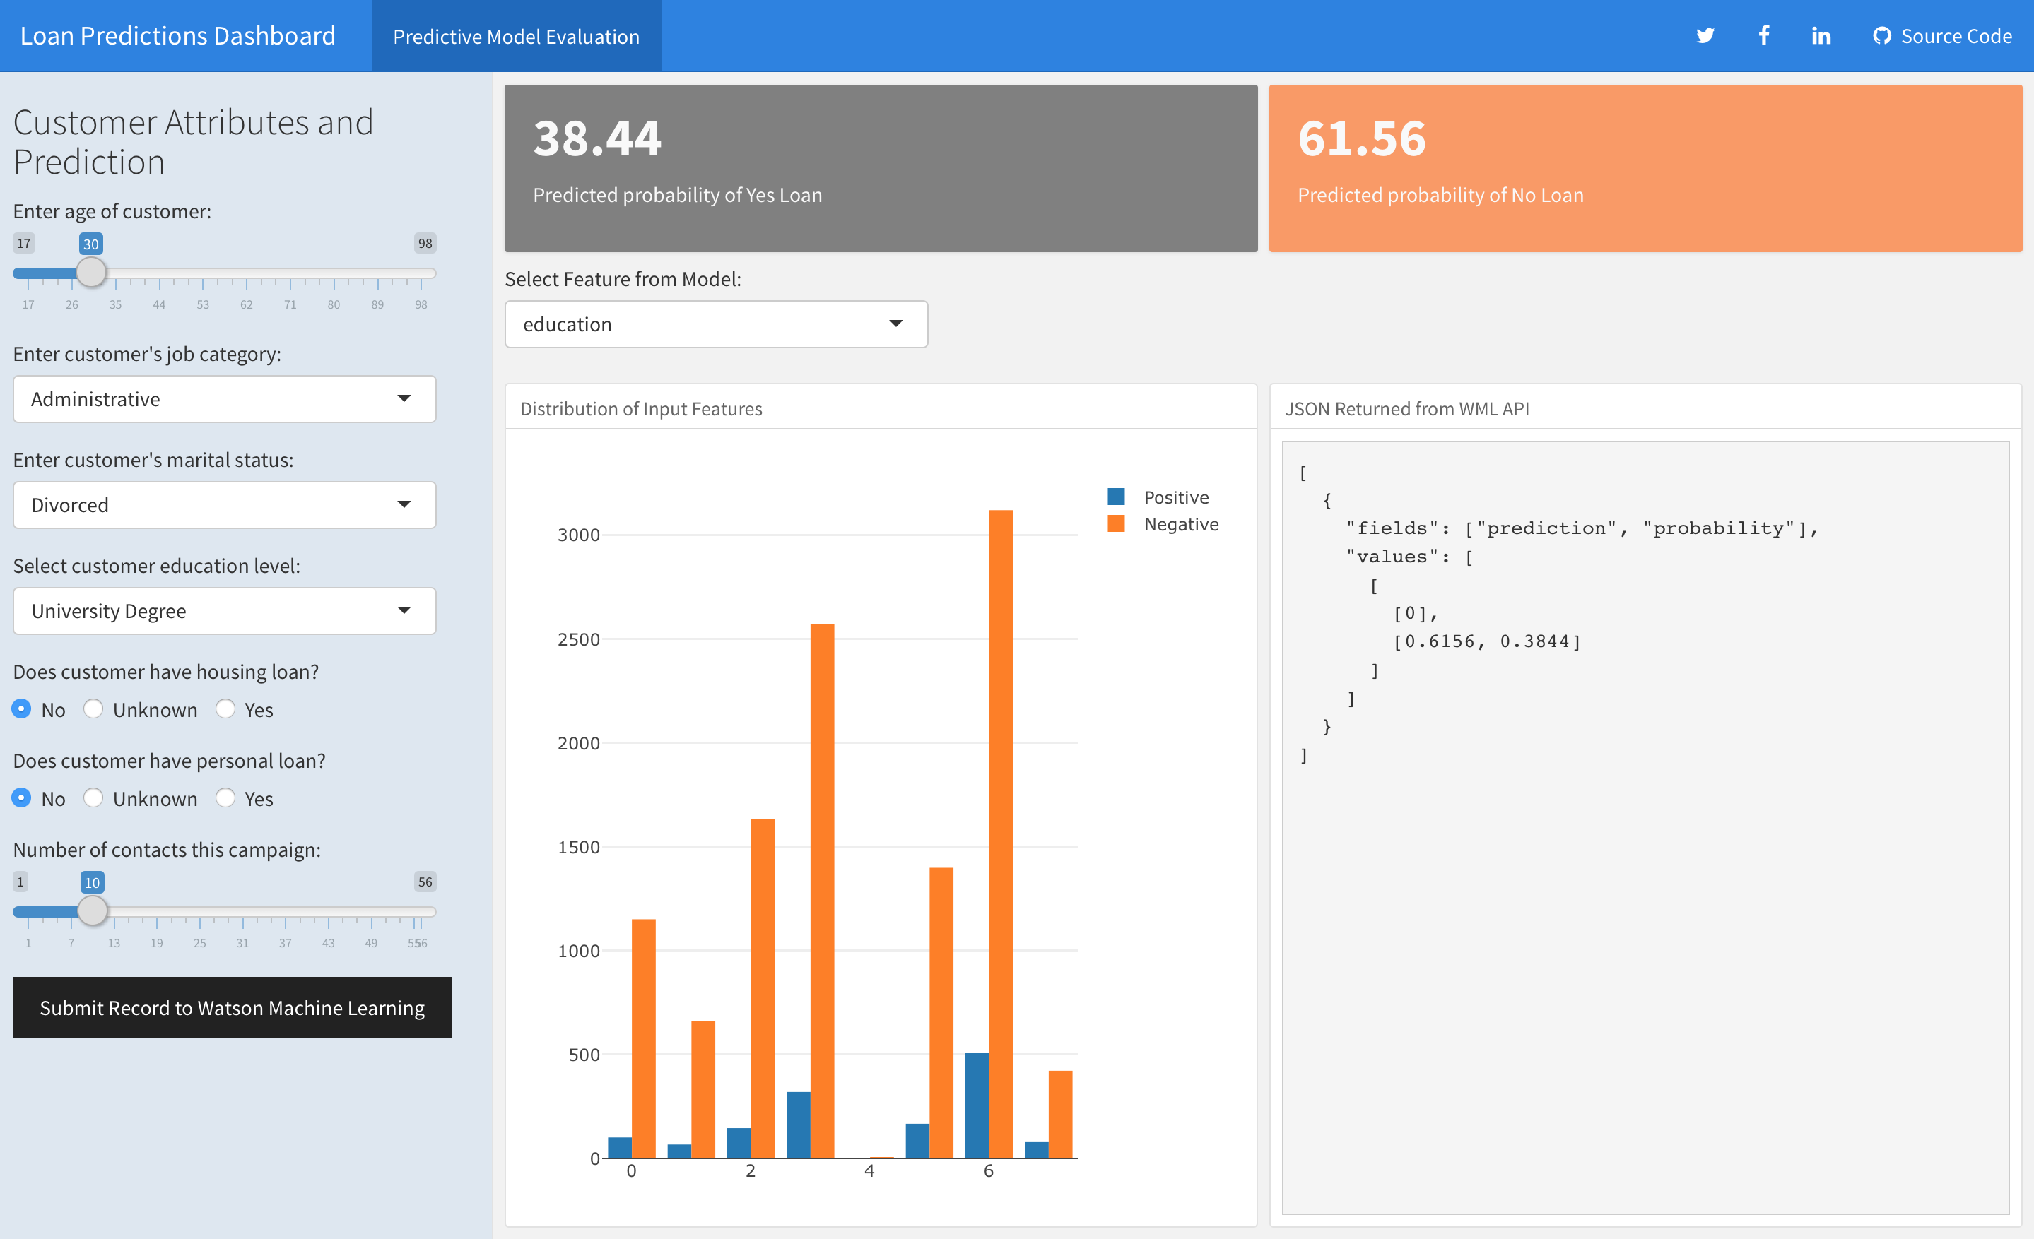
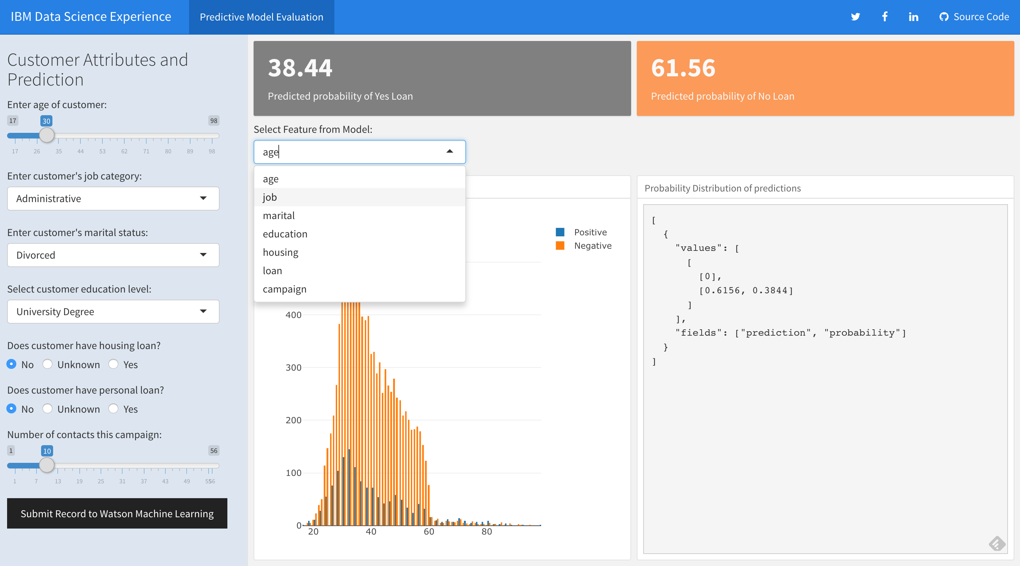
What we’re building today…
…using only R
Notes:
This dashboard was created with only R code. It may not be the prettiest, but I put this together to show some things easily possible with R Shiny. The purpose of this dashboard is to score and validate the model performance of a deployed random forest model built in Data Science Experience and deployed with Watson Machine Learning. These two services are used together to help you build and deploy your analytics work. In this dashboard I have the seven features of my model along with inputs I can manipulate before hitting score to see the resulting scores on the dashboard. I also have a drop down where I can check the distribution of customers by variable in my data set compared by those who have or have not signed up for my bank’s new loan offer. This is the start of what is possible with R Shiny, and if we have time today you can try adding on to this

Slide 4
A Shiny Introduction:
Understanding Web Apps with R

Slide 5

Shiny Questions Answered
What is R Shiny?
Web app framework
Uses only R code to build interactive web applications
Open source project created by RStudio
Why use Shiny?
Provides quick way to go from analysis in R to interactive applications
Offers more flexibility than commercial BI tools
Share your analysis easily via URL
How to get started?
Very easy if you already have Rstudio (just installing an R package)
Many tutorials online
Flexdashboard is an easier way to get started with Shiny

Slide 6
Shiny Application Architecture
R Scripts
R Scripts
R Scripts
Cached Data
Web Server
Web Browser
Web Browser
Web Browser
~Shiny~
Data Sources
Notes:
This is a high level architecture that can help you think of what is happening with our Shiny app. Starting from the far left we have the web browser and the cached data. This is where the user of your dashboard will interact with visualizations and any controls in your application. The cached data is stored on the client side – in the web browser – and this is what visualizations are drawn from. If you have a small enough data set you can just have a web page that has all the data cached so any visualization that needs to be redrawn can be handled client side. Since that isn’t the case for most data sets, we have Shiny to help make it easy to work with the server to get the data or execute any functions on demand based on what the user does. In a shiny app, we use R code to define what functions are executed and work with R data objects that we can slice and dice before serving up to the client side. We also have our data sources behind the server so if we need to query the database for more data that is also possible. In the middle is Shiny because it is the magic glue that makes it easy for us to just use R to make this all happen that ends up in a URL you can share with your team.

Slide 7
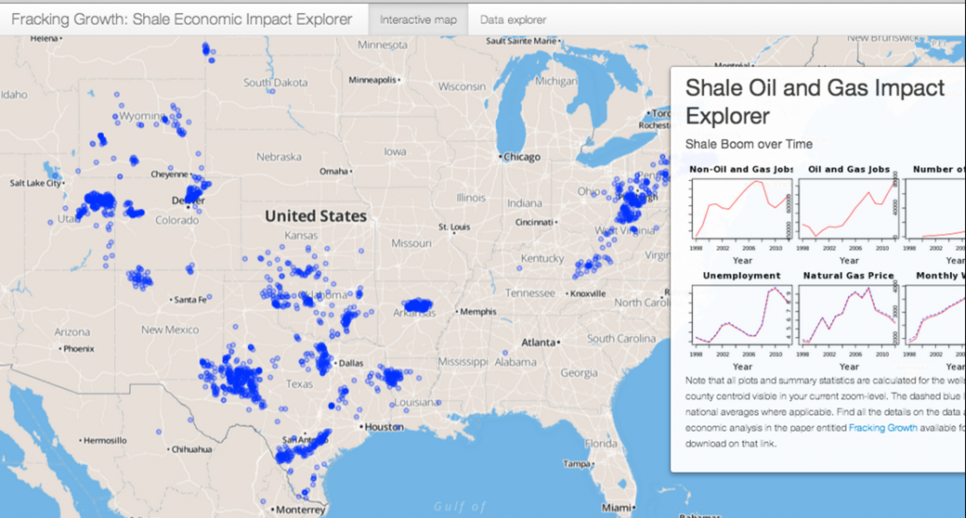
Shiny: the good / the bad
Pros
Open source and free to use
Works well for small/med data sets
Many R packages available for viz**
Flexible framework for development
Bound by limits of what is possible with code
Build apps with only R
Cons
Not great for big data
Limiting if custom visualizations are needed
Requires some R skills
Requires a Shiny Server to deploy
**Example of Geospatial Shiny App
Notes:
Geospatial is actually a really powerful capability of shiny apps. The example screenshot above shows an example of it in action.

Slide 8
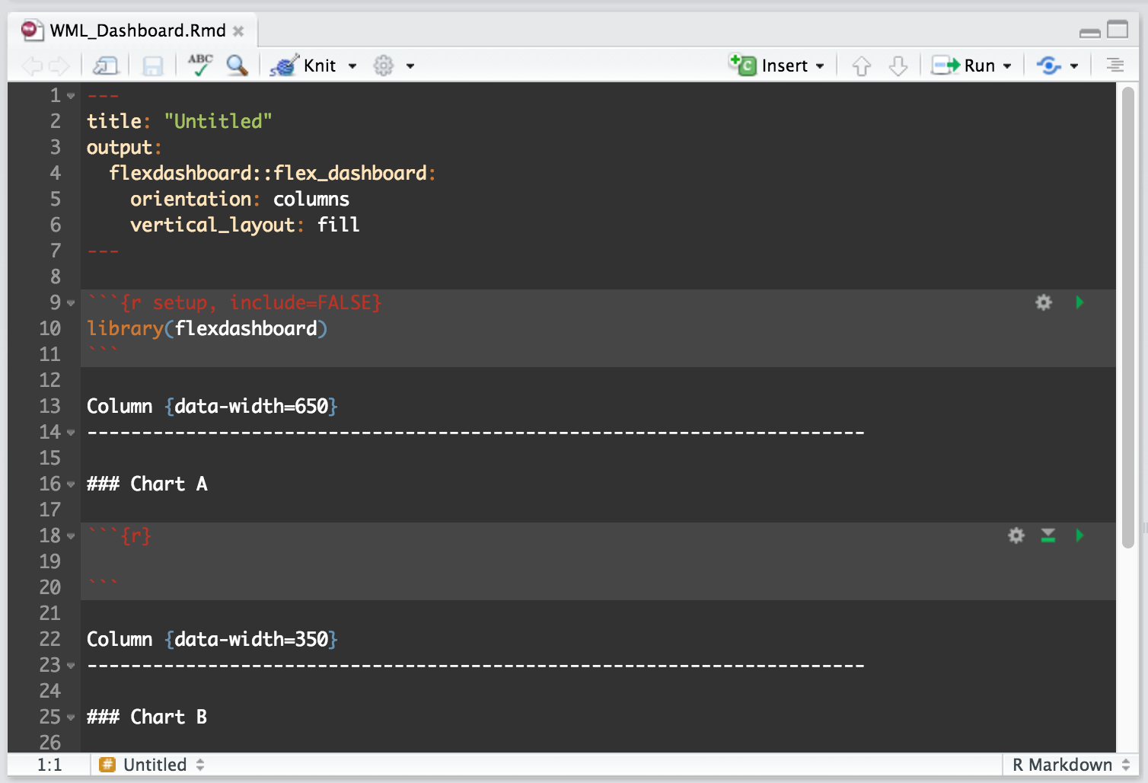
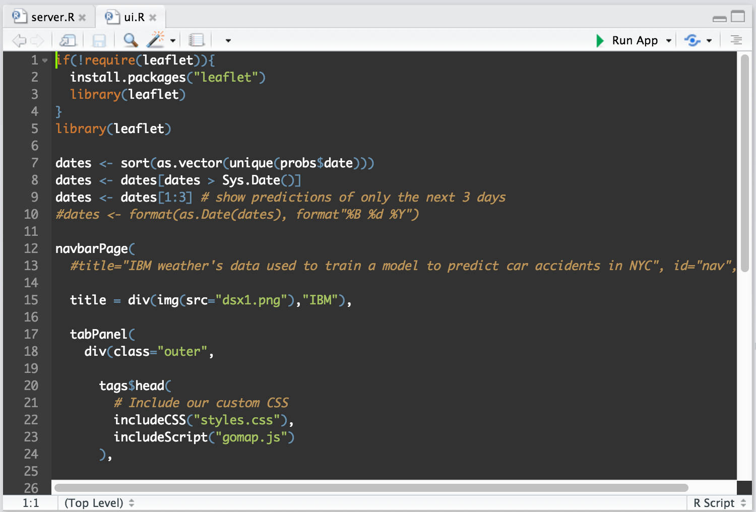
A note on Flexdashboard
Flexdashboards are created in a single R Markdown document to simplify development and provide structure. Easiest to go from R script to dashboard.
Pure Shiny apps can offer more flexibility but also can add complexity (i.e. more R scripts handling different parts of the app)
Flexdashboard → shinydashboard → shiny
Notes:
Today we will be using Flexdashboard to build a dashboard in R. I personally prefer this for my projects since it provides enough flexibility and control I need with giving me a dead simple development framework. All we do with flexdashboard is fill in a R Markdown document with chunks of R code we want in different sections and it compiles into a web app for us.
Shinydashboard is a bit more flexible but also introduces multiple files for your app. This can be really helpful when your project starts to grow but also has slightly more of a learning curve and adds some complexity.
Pure shiny is even more flexible. With shiny you are even more free to do whatever you want, but you lose some of the nice features of the dashboard packages that provide really clean templates and built in capabilities to make it simple to create interactive apps.

Slide 9
Running your first Shiny Dashboard:
Hello world!
Notes:
Let’s take a poll now – do we want to see a hello world example and take a deep dive into shiny or just get everyone up and running with their own dashboard and work backwords.
Raise your hand if you want to see the hello world example
Raise your hand if you want to move on to the full dashboard

Slide 10
Get to RStudio!
Using Data Science Experience
Go to datascience.ibm.com
Hover over tools in top navigation → Click RStudio
Using a local Rstudio instance – open RStudio

Slide 11
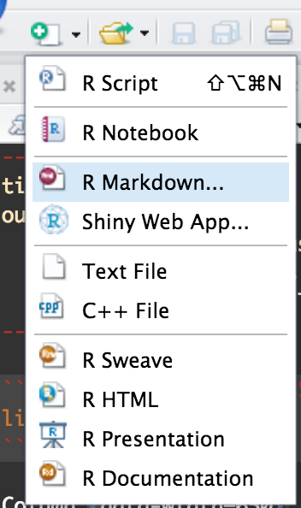
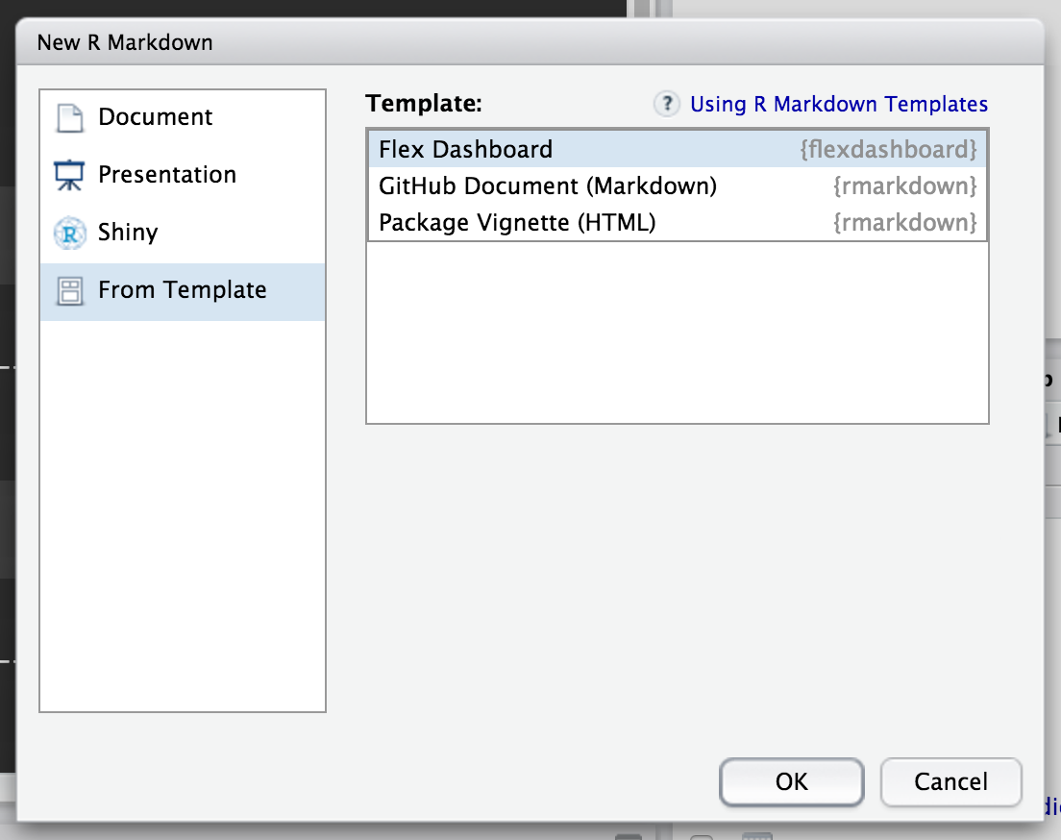
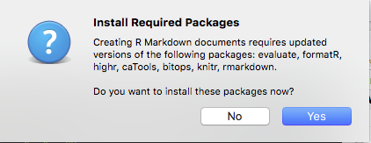
Install Flexdashboard and create an R Markdown document
0. Install:
3. If it is the first time creating this, you will see a pop-up to download packages, click Yes
1. Create new Document
2. Choose ‘From Template’ and select Flex Dashboard

Slide 12
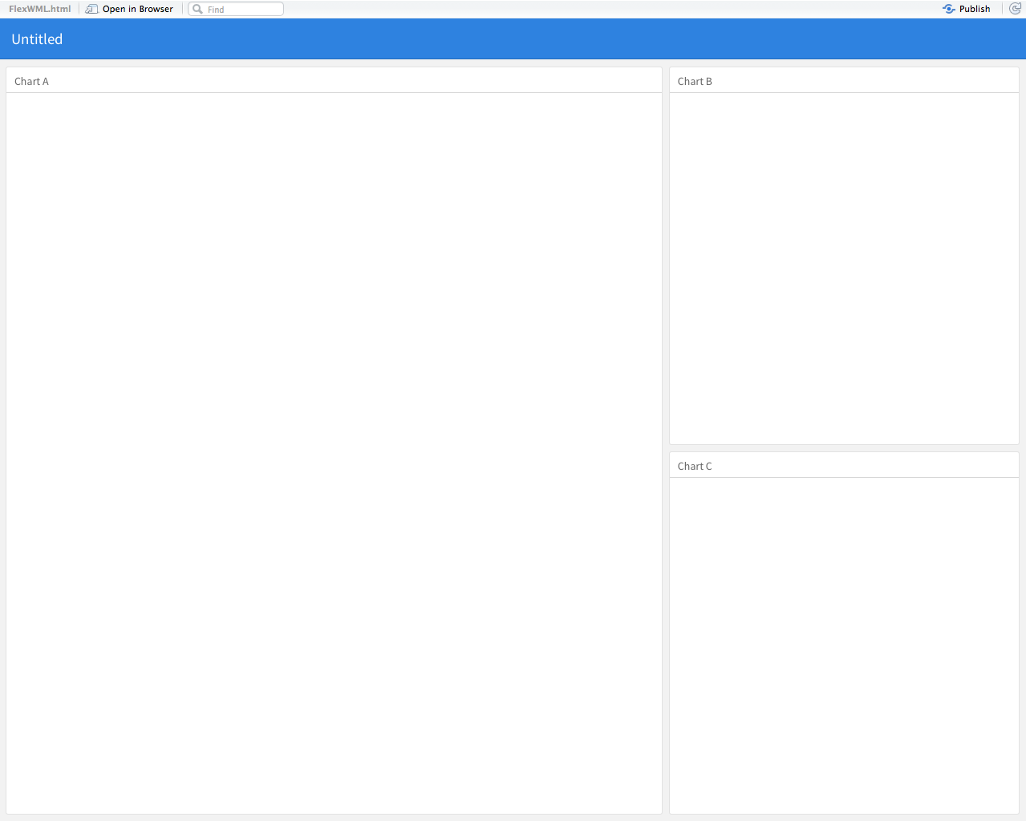
Knit R Markdown to turn into Dashboard
Clicking ’Knit’ in the Rstudio UI will compile the R Markdown
Need to save at this point if you have not already
You just created an empty dashboard!!

Slide 13
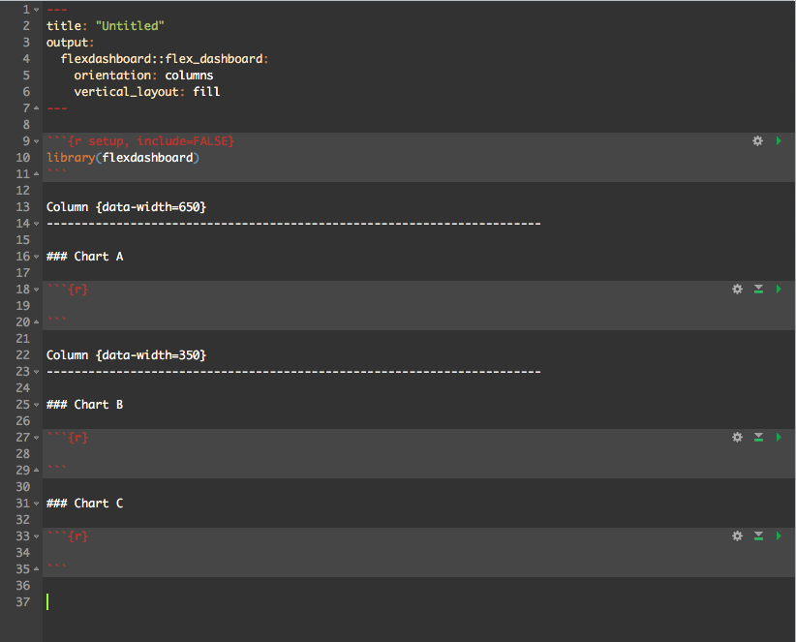
Flexdashboard Document Overview
Header Nav: configured at the top of the doc
Column 1: 1 placeholder
Column 2: 2 placeholders
Notes:
This is the best way to see what is happening with a flexdashboard document.
The markdown document on the left directly maps to the compiled application on the right. Starting at the top we have meta data to help describe the behavior of the app. The orientation of columns can be seen on the right as the column sections of the document create empty columns. The second chart in the second column splits the column to create a row. If you wanted to have wider charts you can orient to Rows and split rows to create columns. The blank sections following each of the headers like ### A/B/C are where we add our R code to create a visualization or output/input we want.

Slide 14
Building a predictive dashboard:
With Watson Machine Learning and Shiny

Slide 15
Load dependencies, Clone and Run
Go to: https://github.com/gfilla/BankLoanPrediction/ - follow the instructions for loading dependencies
Clone repository into your RStudio working environment
Run the R Markdown document with the dashboard
> system("git clone https://github.com/gfilla/BankLoanPrediction.git")
> rmarkdown::run("BankLoanPrediction/dashboard/bankPredictionWML.Rmd")

Slide 16
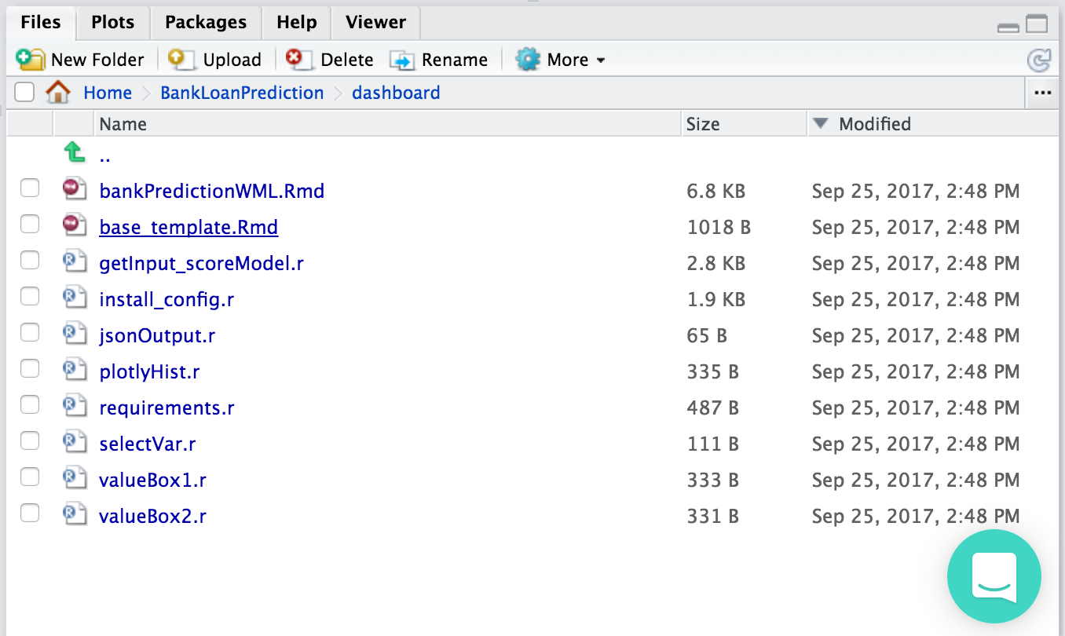
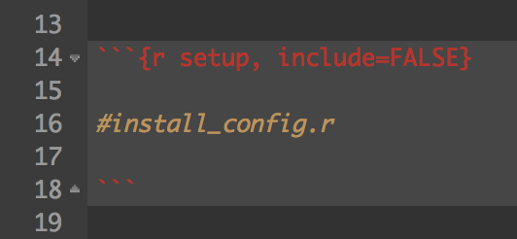
Filling in the template
Open the base_template.Rmd file
Open the R scripts in this folder to paste in the template
3. At any point – you can view the dashboard by executing:
rmarkdown::run("BankLoanPrediction/dashboard/base_template.Rmd")

Slide 17
Packages Used
Flexdashboard - converts a .RMD to a shiny app
Shiny – let’s us use all the shiny components / reactive functions
Dplyr – helps with data cleaning
Jsonlite – JSON helper – packaging up data as JSON to send for scoring
Httr – http library for making requests to score the model
R4WML – helper library for scoring Watson Machine Learning models
objectStoreR – helper library for working with Swift Object Storage
Plotly – interactive data visualization tool

Slide 18
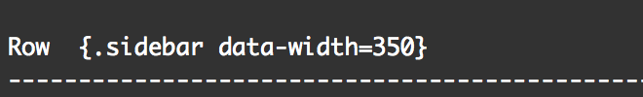
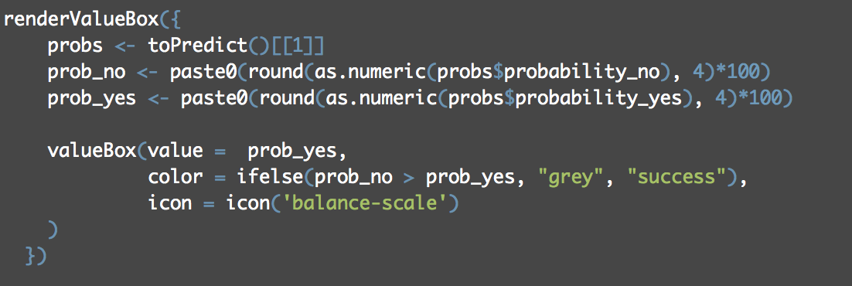
Component Breakdown (1)
Sidebar
Value Boxes

Slide 19
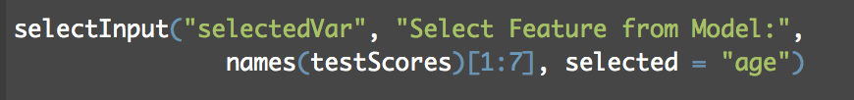
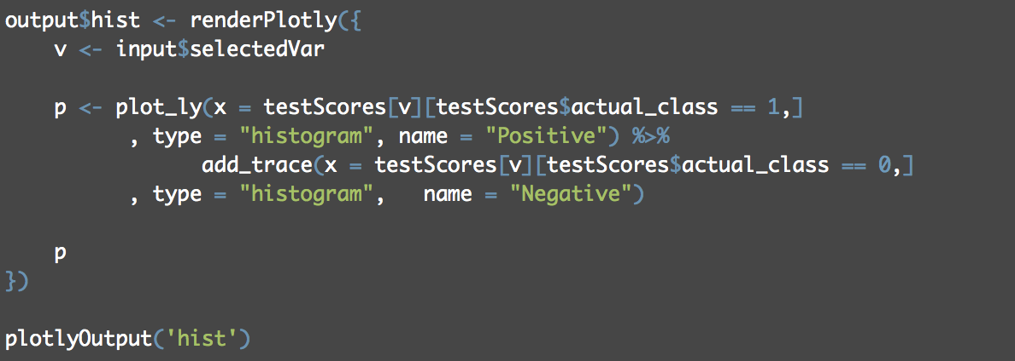
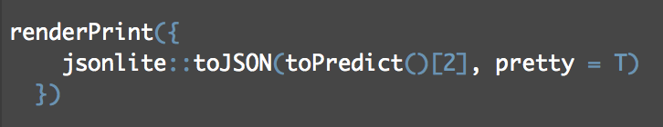
Component Breakdown (2)
Plotly Visualization
User Input
Plotting code
Print JSON

Slide 20
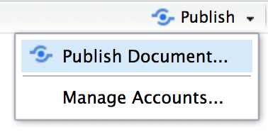
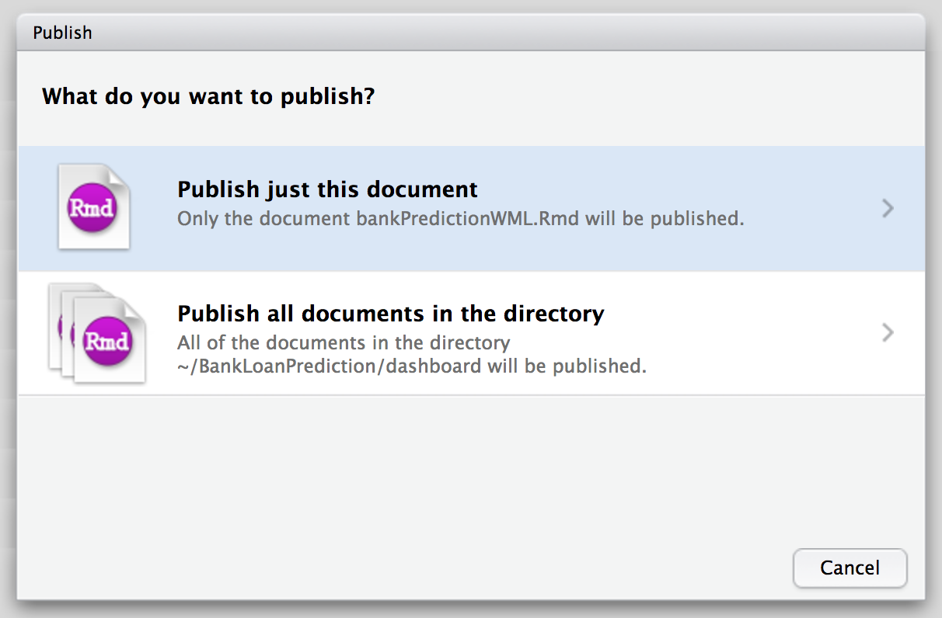
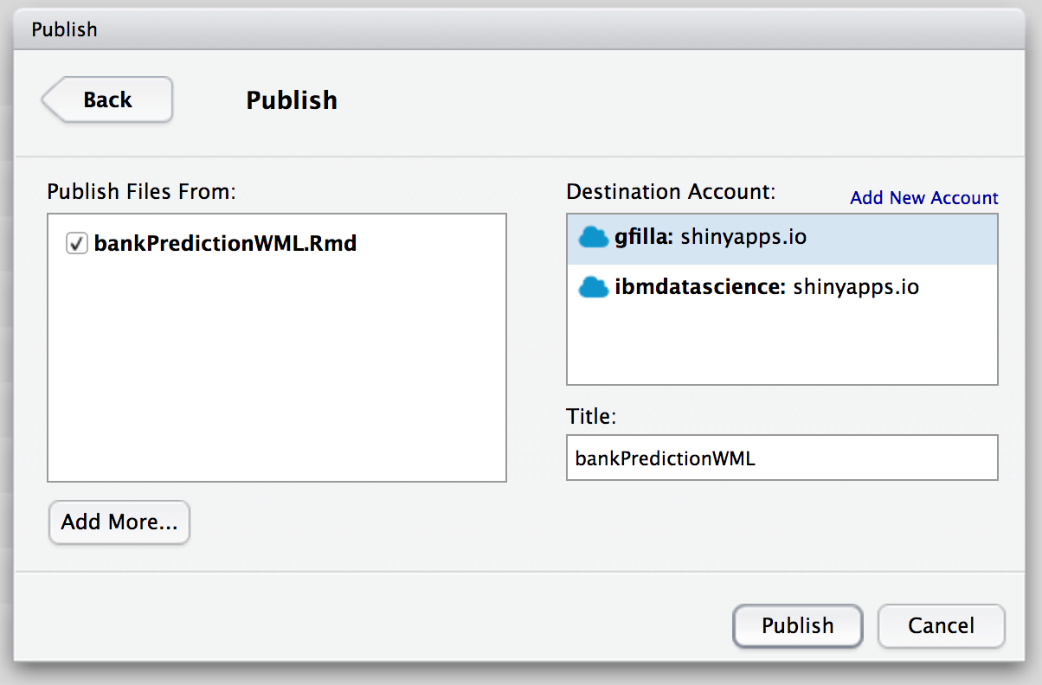
Deploying on Shinyapps.io
This is in the top right when viewing the dashboard

Slide 21
Visit your live dashboard!
https://gfilla.shinyapps.io/LoanPrediction/

Slide 22
Thank you
IBM Analytics | Global Elite
22

